Slide 1
Understanding materials and inputs
Introduction to WebGL 3D with HTML5 and Babylon.js

Slide 2


WHO ARE WE?
Geeks, web developers, 3D addicts
DAVID ROUSSET
DAVID CATUHE
TECHNICAL EVANGELIST
PRINCIPAL PROGRAM MANAGER
Twitter: @davrous
http://blogs.msdn.com/davrous
Twitter: @deltakosh
http://blogs.msdn.com/eternalcoding
Do not try to tune your speakers, the weird sound is due to French accent…

Slide 3


Course topics
Introduction to WebGL 3D with HTML5 and Babylon.js
Day One
01 | 3D on the Web: Understanding the Basics | 02 | WebGL Basics
03 | Using Babylon.js for Beginners | 04 | Understanding materials and inputs
Day Two
01 | Game Pipeline Integration with Babylon.js | 02 | Loading Assets
03 | Babylon.js: Advanced Features | 04 | Special Effects

Slide 4
TEASER – WHAT YOU’LL LEARN
DEMO
Notes:
Scenes with all the beautiful spheres
3D Maze with the gamepad camera

Slide 5
AGENDA
1
Materials
2
Working with inputs

Slide 6
Section One
Materials

Slide 7
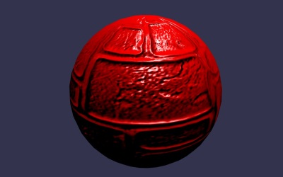
Uber shader - StandardMaterial
StandardMaterial hides shaders complexity
It supports:
Diffuse
Specular
Emissive
Bump
Opacity
Ambient
Reflection
Alpha

Slide 8
DISCOVERING THE STANDARDMATERIAL
DEMO

Slide 9
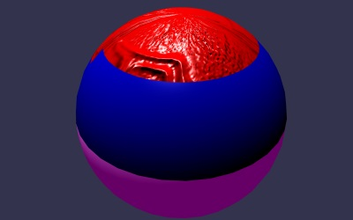
MultiMaterial
Container allowing you to apply many materials to a single object
Segment a mesh into sub-meshes

Slide 10
USING MULTIMATERIALS
DEMO

Slide 11
Dynamic texture
What about using canvas 2D API to generate texture content?
This is the magic done by BABYLON.DynamicTexture
All 2D API are available (Text, Arc, etc..)
Warning: each update will trigger a copy to GPU memory

Slide 12
USING DYNAMIC TEXTURE
DEMO

Slide 13
Section Two
Working with inputs

Slide 14






PLAYING WITH INPUT
Device Orientation
Virtual Joysticks
Touch
Anaglyph
Oculus
Gamepad
Using pointer events, this camera generates two joysticks on top of the scene
Use this camera with Red/Green glasses
Use your gamepad to control your camera
Camera based on Device Orientation API
Control camera orientation with Oculus Rift device
Camera based on pointer events

Slide 15
CAMERAS & INPUTS
DEMO

Slide 16
Going further with some online tutorials
Materials
Creating a 3D WebGL Procedural QR-Code Maze with Physics

